Slide 1
Child Genius
Paul Bertrand

Slide 2
Definition
a child with a skill set or an ability that is incredibly accomplished, far beyond their years.
a prodigy whose talents are recognized at an early age; "Mozart was a child prodigy”
a child who is extremely skillful at something that usually only adults can do.

Slide 3
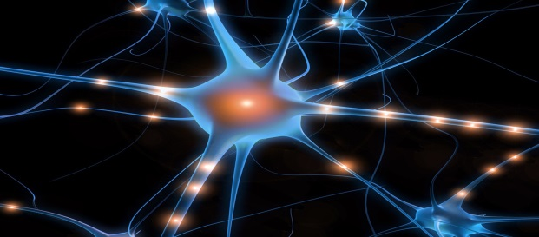
Starting at a Young Age
Every child has genius potential, if teaching and learning begins at a very young age.
A child's brain is growing and developing at a
rapid speed.
Hands-on activities activates nerve cells in the brain stimulating them to create neurological pathways which help the brain to grow.
Notes:
Finish point 2
Define “neurological pathways”

Slide 4
Ender Starting Young
At age 6, Ender was already shipped to Battle School and learning in an extreme environment.
“This was school. Every day, hours of classes. Reading. Numbers. History.” – Ender Wiggin
The battlerooms were a perfect physical exercise that forced Ender to think, strategize and perform differently with every battle.

Slide 5
Independence is Key
Let the child figure out problems on their own and be self-reliant.
Children need to understand that parents or adults won’t always be at their side for support.
Understanding how to problem solve and get around obstacles on your own will help when future challenges occur.
Independence leads to creating thinking that
will make new ideas and improve knowledge.

Slide 6
Enders Isolation
Graff purposely separated Ender from the rest of the children at Battle School so that Ender couldn’t make friends forcing him to believe and relay solely on himself
“ And when I tell you Ender Wiggin is the best in this launch, take the hint, my little dorklings” – Graff
Connections with family members back on earth or new friends at Battle School can be a major distraction.
Notes:
One more Ender point

Slide 7

Local Genius
Jake Barnett is a 15 year autistic boy who is
currently studying Theoretical Physics at the
Perimeter Institute in Waterloo.
At a young age, Jake was diagnosed with
moderate to severe autism and was told that
he would be lucky if he could read and write.
Proving the doctors wrong, Jake enrolled at Indiana University at age 11 and later switched to the Perimeter Institute to advance his learning.
http://www.youtube.com/watch?v=Uq-FOOQ1TpE

Slide 8
Autism vs Genius
Similarities and Differences
Autism - It is a lifelong disability that affects the way in which a person communicates and relates to other people.
Similar | Different
May have trouble expressing emotion, often purposely isolates themselves for social activities. Daily routines or small rituals are common, if disrupted anxiety and frustration occurs. | An autistic child may enjoy constant repetition, where a gifted child will bore and is eager to learn more. A gifted child is fascinated with speech and words, an autistic child may have many learning disabilities.

Slide 9
Child Intelligence Facts
A child’s brain is at 90% potential growth by age 5.
Talking, singing, playing and reading are some of the key activities that build a child's brain
Early experience and interaction with the environment are most critical in a child's brain development.

Slide 10


Disadvantages of being a Genius
Sending children to private schools for
specialized learning and training costs
a lot of money.
Some advanced schools charge up to
$3000 a term, over $700 for school
uniforms and around $600 for private
IQ tests.
“Paying school fees is like paying another mortgage!”
- Kristian Graham, dailymail article

Slide 11
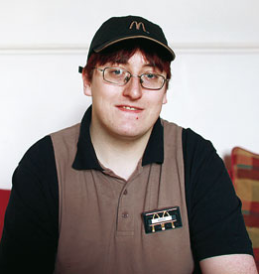
Struggles on being a Genius
Andrew Halliburton, from the young age of two showed a strong knowledge of numbers.
At age 9, Andrew was put into high-level high school math courses.
Even though Andrew is considered a math genius, he really doesn’t enjoy Math at all.
He continued to University, except dropped after the first year. Currently he’s happily working as a McDonald’s employee.

Slide 12
Ender’s Chosen Life
Even though Ender is a genius, did mean he wanted to spend his childhood at Battle School
“I want to go home” – Ender Wiggin
Ender had the weight of the world on his shoulders. Commanding an army to attack the buggers before they had their third evasion.
“everybody will be depending on me, and I won’t be able to do it” – Ender Wiggin

Slide 13
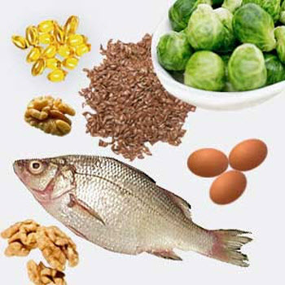
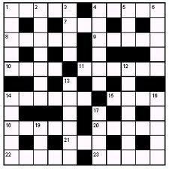
Improving Your Brain
Healthy diet- omega-3 product: nuts, fish, broccoli, olive oil, and many more.
Get your brain active: crossword puzzles, Sudoku's and riddles challenge and stimulates your brain creating new connections in your brain or strengthens existing connections

Slide 14
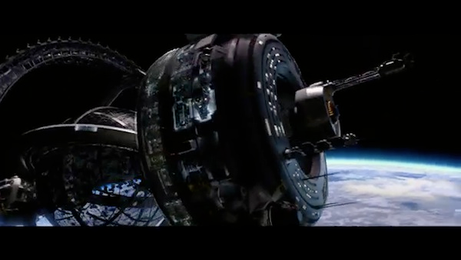
Battleroom
The battleroom let Ender understand how to maneuver in zero gravity and create different strategies to beat his enemy.
“Now, which way is the enemy’s gate?” “Down!” – Ender Wiggin
At Command School, Ender relied on the knowledge he learned from the numerous victories from the battleroom.
Notes:
Final Battle

Slide 15
Conclusion
Although there are great benefits to being a child, it’s not always easy.
In the end, Ender was the saviour of planet earth, except it took a major impact on him.
  Mentally- he felt used by the government.
  Physical- countless hours practicing and training

Slide 16
Barkham, Patrick. "Child Geniuses: What Happens When They Grow Up?" The Guardian. Guardian News and Media, 15 May 2010. Web. 16 Dec. 2013.
Card, Orson Scott. Ender's Game. New York: Tor, 1991. Print.
"Developing the Child Brain." Developing the Child Brain. N.p., n.d. Web. 16 Dec. 2013.
"Discovery Health." Discovery Fit and Health. Richard Mohs, n.d. Web. 16 Dec. 2013.
"Eton and Harrow of England." Eton and Harrow. N.p., n.d. Web. 16 Dec. 2013.
Wells, Paul. "Jacob Barnett, Boy Genius." Macleansca Jacob Barnett Boy Genius Comments. N.p., 1 Sept. 2013. Web. 16 Dec. 2013.
Wharton, Anna. "Why There Can Be a Bitter Price to Pay for Having a Child Genius in the Family: How the Strain of Raising Extraordinary Children Can Even
Break up Marriages." Mail Online. N.p., 21 Oct. 2013. Web. 16 Dec. 2013.
https://www.giftedchildren.dk/open/documents/factsheets/Parents/NAGC%20-%20aeldre%20materiale/factsheets/P64%20Autism%20and%20Giftedness.pdf

